Slide 1
Brand Positioning and Strategy
Travis Mayo
Columbia Southern University

Slide 2
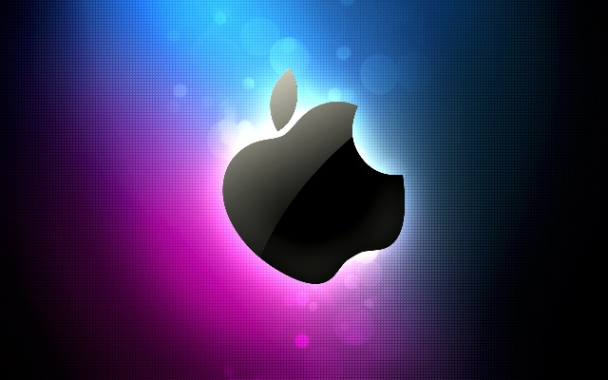
Introduction
One of the most favorite brand that is appealing to me is the apple.
Apple has a brand with a value of 146.3 billion.
Apple is appealing to most due to the products offered to its customers.
Notes:
There are various reasons as to why apple brand is the most appealing to most people.
First, apple brand always takes enough time to make and design their products thus giving quality .
People love apple because the brand is consistent and they do not change the brand time to time.
Apple brand also keeps evolving and they keep on launching new products each and every time.
When people are using the brand, they feel good about themselves and this is one of the reasons apple has gained popularity across the world.

Slide 3
Con’t
Apple has become one of the most leading brand around the world.
(Burgess, 2012).
The founders of apple brand were Steve Jobs, Ronald Wayne and Steve Wozniak.
Its now 42 years since apple brand was created.
Notes:
The company was started in the Santa Clara valley in California.
The company was involved in the creation and design of electronics, personal computers, servers and computer software.
Over the past years, the company has been involved in developing its brand for better customer satisfaction.

Slide 4
Brand products
Apple brand has got the following products.
Among all products in the apple brand, the following are favorites;
iPhone smartphones
Apple smart watch
Ipad tablet computer
Notes:
apple has got many of the products and services that they offer to their customers.
Apple offers the following services;
Apple store
iTunes store
iBook store
iCloud
Apple Pay
App store
Apple offers the following products;
iPod
iPhone
Apple watch
Mac OS
Apple TV
Macintosh
Logic Pro among others.

Slide 5
Gain of Market Share and Popularity
Apple brand has gained market share and popularity in terms of brand recognition , brand strategy and product positioning in the following ways;
In terms of brand recognition, it has gained popularity through;
Being able to penetrate the global market through online community.
Direct sale of their products
Retail stores that are available globally.
(Hitt, Ireland, & Hoskisson, 2012)
Notes:
Apple brand has been able to sell its products online which is the main source of their income.
The brand company has also been able to make its sales through direct sales of the products from various stores that are found in different parts of the world.

Slide 6
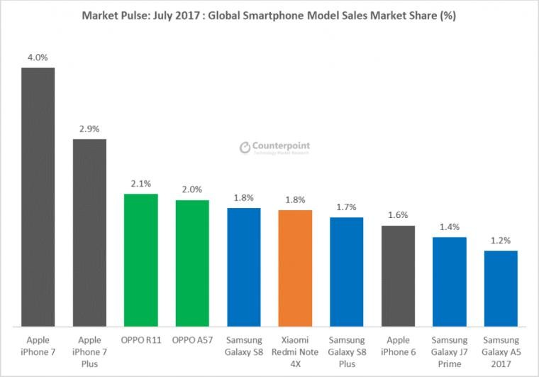
Market Share of Different Brands in the Year 2017
Notes:
The graph above shows the market share among various brands.
From the graph we can see that apple products are the leading in the market share with the highest percentage.
This means that the brand has adopted the best marketing strategies thus gaining popularity around the globe.

Slide 7
Brand strategy and Product Positioning
Apple’s brand strategy and product positioning has been used by apple brand to gain popularity and market share around the world.
Apple uses emotional brand positioning strategy.
According to Feng (2014), there are several factors that promote to a strong brand name.
Notes:
Brand strategy is a plan laid in place for development of a brand to attain certain future goals.
Product positioning is marketing to the consumer through explaining the benefits of the products.
Both brand strategy and product positioning are the most important in components of marketing.
Emotional branding means that the brand is felt at heart and mind of the consumer.

Slide 8
Con’t
This factors are;
The name of the brand used.
How the brand has developed.
Brand positioning
How the brand has been sponsored.
The company has gained a lot of success since it has incorporated the above factors thus leading to success of the company.
(Feng, 2014)
Notes:
Apple has been able to use the above factors for its success.
The name of the brand that has been selected has gained a lot of popularity globally.
Brand development means growing of the brand.
Apple brand has been the most innovative brand always creating the best designs of their products.
The company has also a very unique verbal and visual vocabulary.

Slide 9
Value Creation by Apple Brand.
Apple brand uses various methods to create value to its product;
innovation of new products.
Providing benefits to customers.
Providing happiness to the clients.
Keeping people at jobs they are best at.
Notes:
Value creation has been used by most of the companies for their brands to achieve a competitive advantage from other companies.
Value creation by apple brand is achieved through innovation of newly improved products .
They also make their customers feel good about the products they are using.
By placing people at jobs they are best at makes them do what they are best at thus making them offer high quality products.

Slide 10
Conclusion
In conclusion, when the right strategies are applied towards marketing of the of the brand, success is achieved.
Apple is my favorite brand since it has got unique products offered to the consumers.
The brand company has also been able to gain market popularity by using the best communication methods to market their brand.

Slide 11
References
Burgess, J. (2012). The iPhone moment, the Apple brand, and the creative consumer: From “hackability and usability” to Cultural Generativity. In Studying Mobile Media (pp. 36-50). Routledge.
Feng, N. (2014). Building a Strong Brand and managing Brand. ASEE 2014 Zone I Conference. Bridgpeort, USA
Hitt, M. A., Ireland, R. D., & Hoskisson, R. E. (2012). Strategic management cases: competitiveness and globalization. Cengage Learning.

